Slide 1

Collaborations and Teamwork!
@Shubhangi_0304
By Shubhangi Gupta
MSP India

Slide 2

Motto!
@Shubhangi_0304
Illustration by @stephaniemadeit

Slide 3
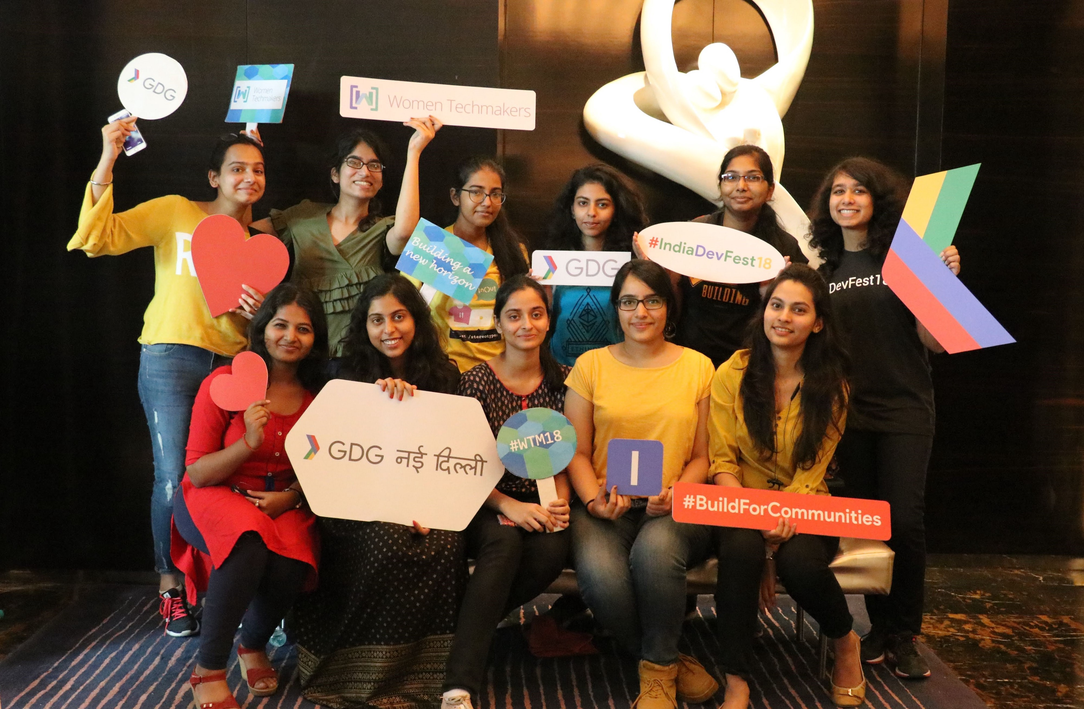
My first meetup!
Blog - http://bit.ly/gdgmedium

Slide 4
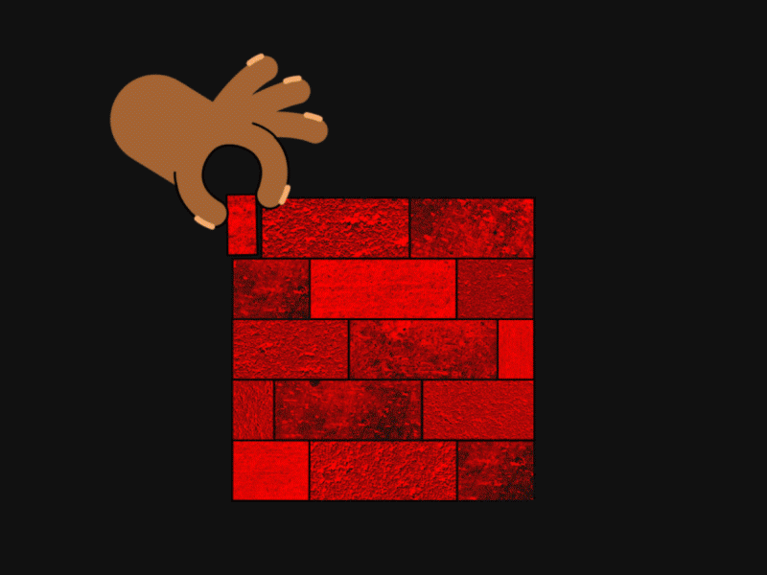
Why collaborate ?
@Shubhangi_0304
Shared pool of resources
Exposure
New ideas
Support
Illustration by @jacobrichardson

Slide 5

@Shubhangi_0304
Why collaborate ?
Shared pool of resources
Exposure
New ideas
Support

Slide 6
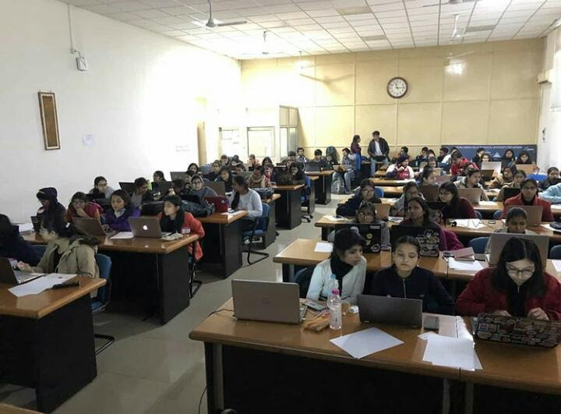
@Shubhangi_0304
Why collaborate ?
Shared pool of resources
Exposure
New ideas
Support

Slide 7

@Shubhangi_0304
Why collaborate ?
Shared pool of resources
Exposure
New ideas
Support

Slide 8

@Shubhangi_0304
Why collaborate ?
Shared pool of resources
Exposure
New ideas
Support

Slide 9
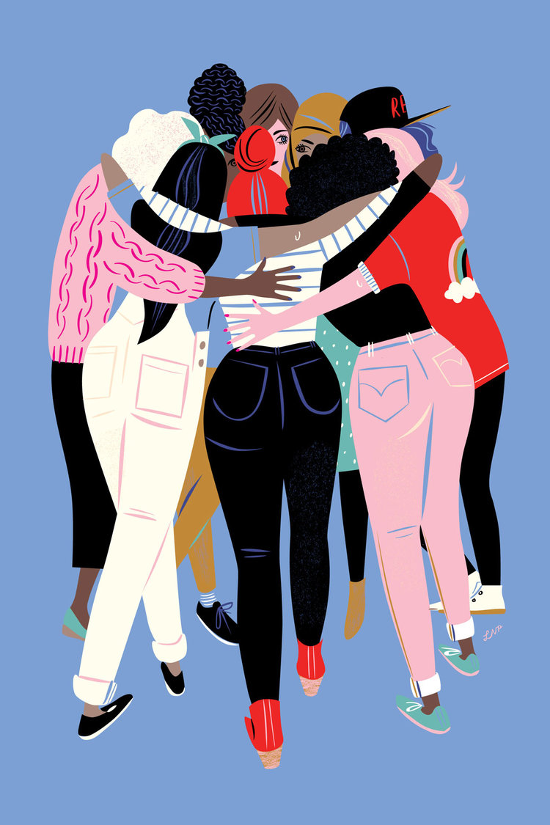
Teamwork!
@Shubhangi_0304
Illustration - https://www.libbyvanderploeg.com/#/reflections-on-the-march/

Slide 10
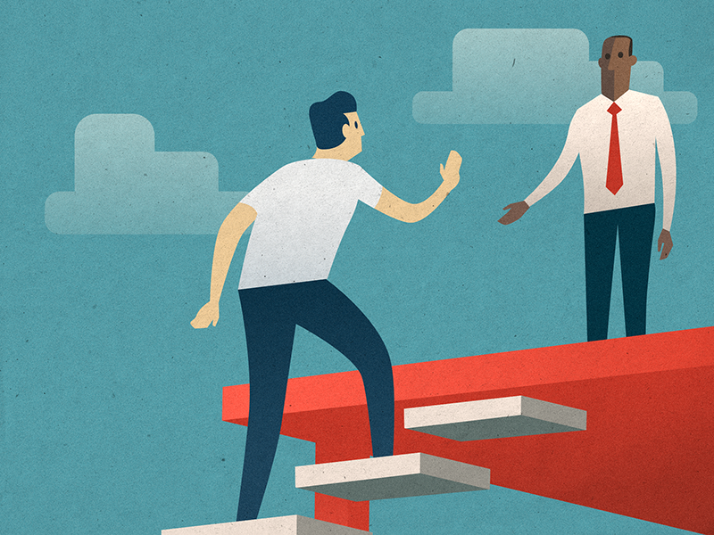
What’s the catch ?
@Shubhangi_0304
Of being a “likeable” leader
Knowing your team
Empathy
Be friendly !
Errors, the right way
Be yourself !

Slide 11

@Shubhangi_0304
What’s the catch ?
Of being a “likeable” leader
Knowing your team
Empathy
Not being bossy !
Keeping a task list
Errors, the right way
Be yourself !

Slide 12
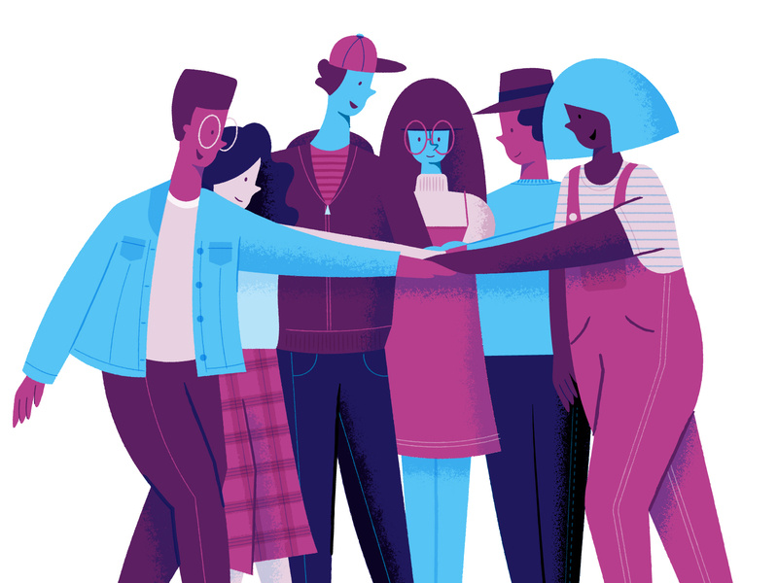
@Shubhangi_0304
What’s the catch ?
Of being a “likeable” leader
Knowing your team
Empathy
Not being bossy !
Keeping a task list
Errors, the right way
Be yourself !

Slide 13

@Shubhangi_0304
What’s the catch ?
Of being a “likeable” leader
Knowing your team
Empathy
Not being bossy !
Keeping a task list
Errors, the right way
Be yourself !

Slide 14
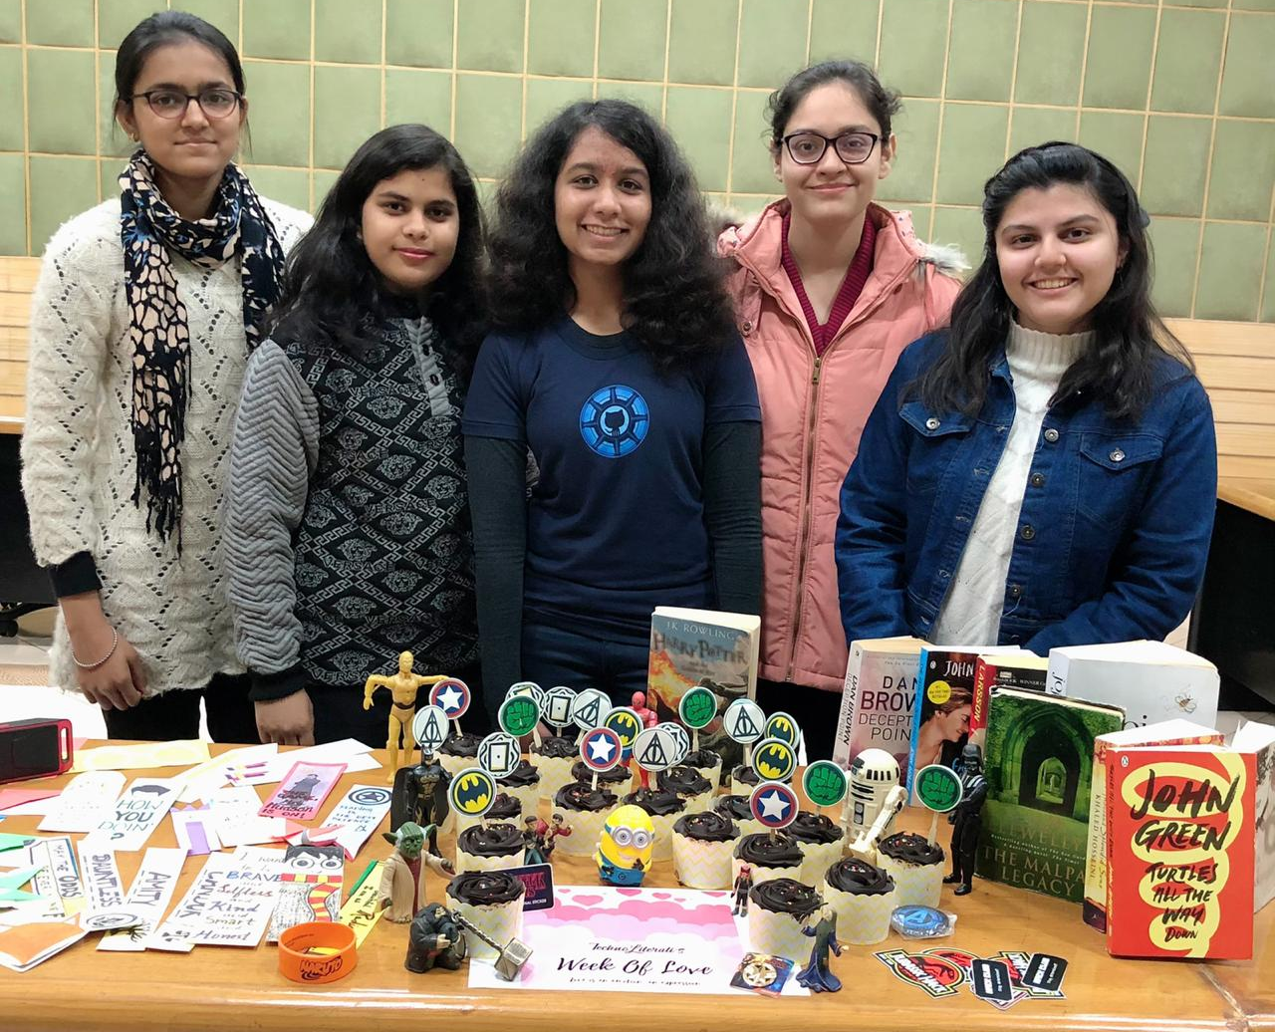
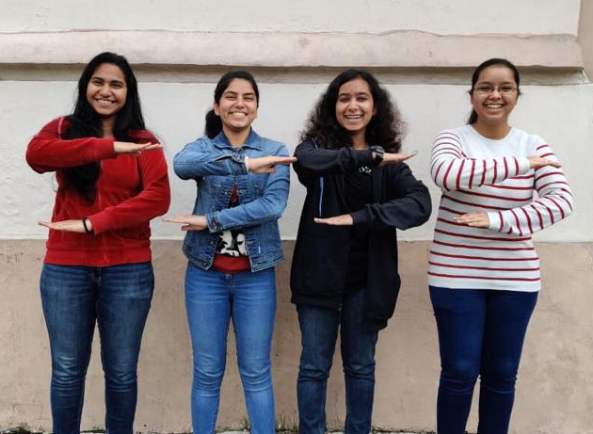
My Team
@Shubhangi_0304

Slide 15

@Shubhangi_0304

Slide 16
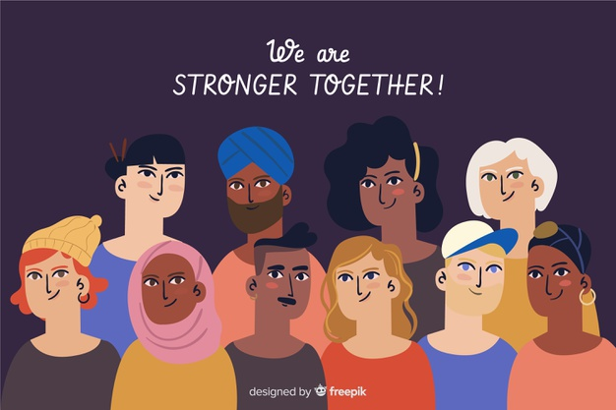
#WomenCan
@Shubhangi_0304

